Slide 1
The Correlation between Political Party and COVID-19 Death in US
Group 8
Sagnik Dutta
Abdullah Ahmad
Mark Ward
Muhan Yu

Slide 2
Introduction
2020 was defined by two major events in our country: The COVID-19 pandemic and the 2020 U.S. Elections (Presidential, Senate and House)
Everyone was affected by COVID-19
Lockdowns, loss of work, general restrictions, social distancing and face masks to name some reasons
Could there possibly be a relationship between these two major events?
Is there a link between State level leadership and the overall percentage of COVID-19 deaths?
We hypothesized that it is likely that COVID-19 responses by state level government could affect how voters pick their candidates.
Some states were more susceptible to the virus than others
Large upticks in New York, California, Texas and Florida to name a few

Slide 3
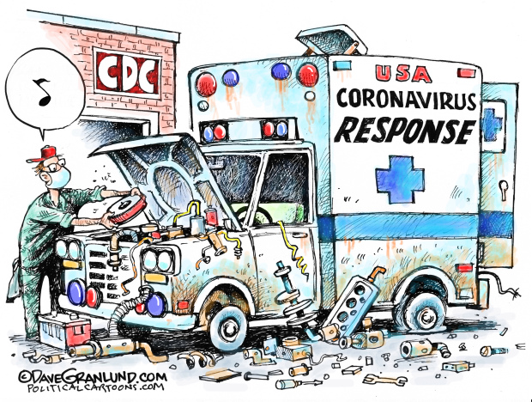
Introduction cont.
Are citizens fed up with how their state government responded to and still faces the pandemic?
Are Red states more at risk than Blue states? Vice versa?
We set out to find a possible link between COVID-19 death count percentage by population and state level political party affiliation
We will further explore if there were any implications relating to the 2020 U.S. elections

Slide 4
Abstract/Problem Statement
Used COVID-19 data from The Center for Disease Control (CDC)
Included: Death counts per state, age groups, relational deaths (influenza, pneumonia)
Appended the CDC data with political affiliation per state
Used state population data to calculate COVID-19 death percentage per population by state
Used SPSS for algorithms to find a possible relationship between state COVID-19 deaths per population and political affiliation
Artificial Neural Network, Bayesian Network and Decision tree

Slide 5
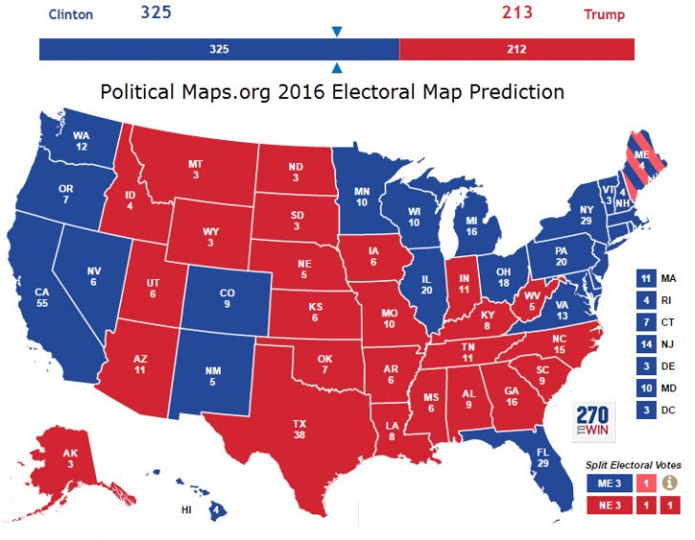
Abstract Cont.
Can we find a relationship between election outcomes and COVID-19 response by states?
Exploring election results and possible causes
This proved to be difficult, we determines that no real outcome can be drawn related to this matter
Too many factors play into how someone votes, and we will never know the reasons for why people voted as a whole

Slide 6
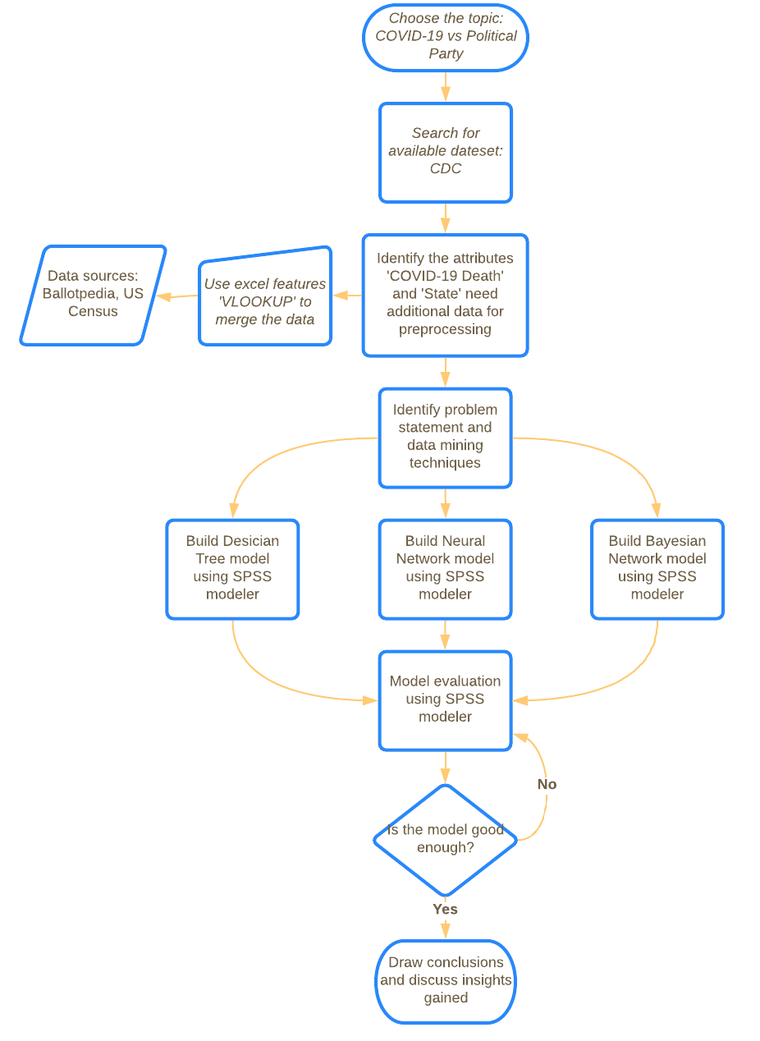
Methodology

Slide 7

Methodology
Data Collection
Main data source: Centers for Disease Control and Prevention(CDC)
Dataset: “Provisional COVID-19 Death Counts by Sex, Age, and State”

Slide 8
Methodology
Data preprocessing
Derive a new field, ‘Party', from the field "State" according to Ballotpedia
Filter out the rows with overlapping age group(“All ages”)
Calculate rate of COVID-19 death in percentage for different states, according to US Census (VLOOKUP in excel)
We may need a binning operation for that new field and the number of bins would be set to five initially and is set to be three after a few attempts.

Slide 9
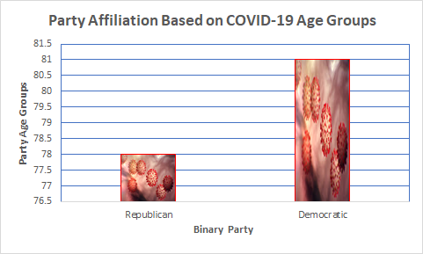
Data Description
Center of Disease Control (CDC)
Sex, Age Group, State
Age Groups: 0-17, 18-29, 30-49 and 50-69
November 25, 2020
Two Binary Groups
Republican State: 78 Age Group
Democratic State: 81 Age Group
Field Parameters
Pneumonia
Influenza

Slide 10
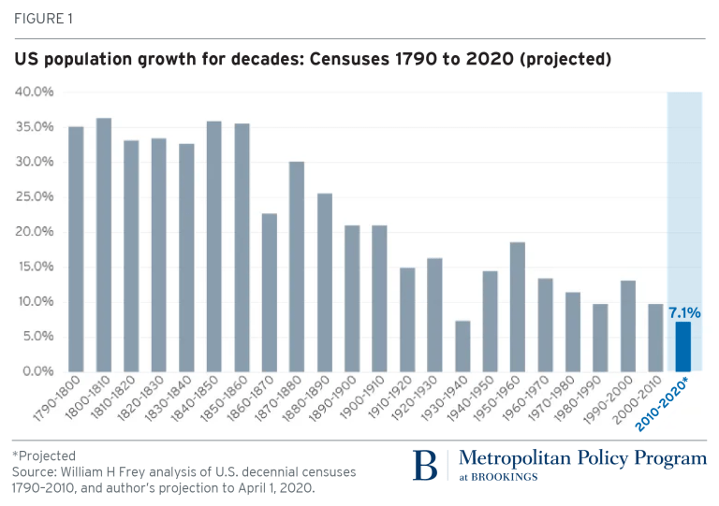
State Population Census
Data Thresholds
2020 U.S. Census
Census Gov API vs.. Sample Population Projections
Percentage of COVID-19 Death by Population
Projected Sample Size: 334,351,340 citizens

Slide 11
Methodology:Model Building and Evaluation
Decision Tree
Neural Network
Bayesian Network

Slide 12
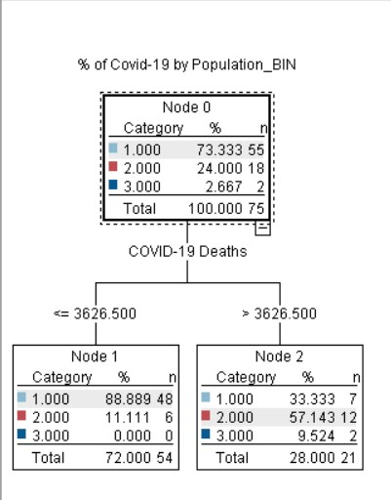
Decision Tree
Six inputs variables and one target variable assigned
Supervised Machine Learning: C.5.0 algorithm implemented
Cross Validation (Five Folds) between Training and Testing set
Bin and Selected Nodes were established

Slide 13
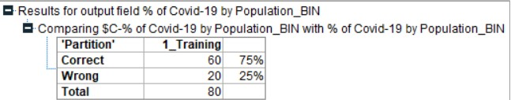
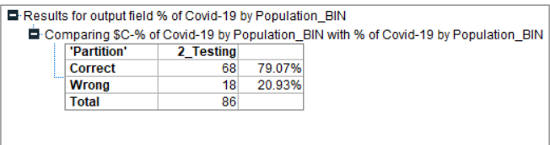
Results & Discussion -- Decision Tree
Classification Score Based On Accuracy:
Training Model: 0.75
Testing Model: 0.79
Predictor of Importance: “COVID-19 Death Value”
Validated large Democratic population samples associated with large pools of COVID -19 Death

Slide 14
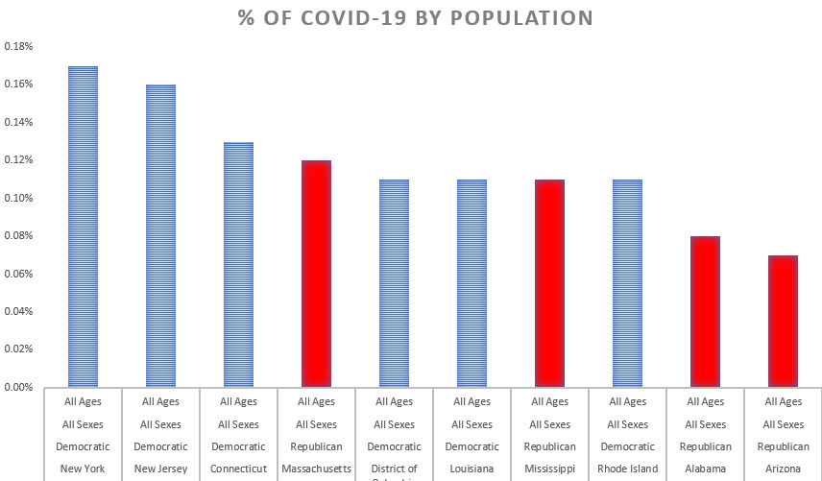
Artificial Neural Network (ANN)
Created a list with the Top 10 states with the highest COVID-19 death % by population (for all age groups and all sexes)
6/10 states were Democratic
The top 3 were all democratic and on average blue states had a higher % rate

Slide 15
ANN cont.
Ran an ANN using State, % COVID-19 Deaths and Sex as inputs with Party as the target
State was the predictor of most importance, followed by % of COVID-19 by pop. then sex.
The ANN was able to predict Party with an accuracy of 99.3%
We found that a model can be trained to predict State Party Affiliation based on % of COVID-19 deaths and state itself
We concluded that Democratic States are more susceptible to COVID-19 deaths

Slide 16
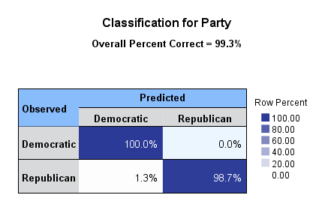
ANN Results
This is likely caused from the overall response from Blue states
Only blue states had a nursing home policy, this led to a large number of Deaths for seniors early on in the pandemic.
Several of the largest cities are in Blue states, NYC was the original hotspot in the U.S. Los Angeles also had a high count.

Slide 17
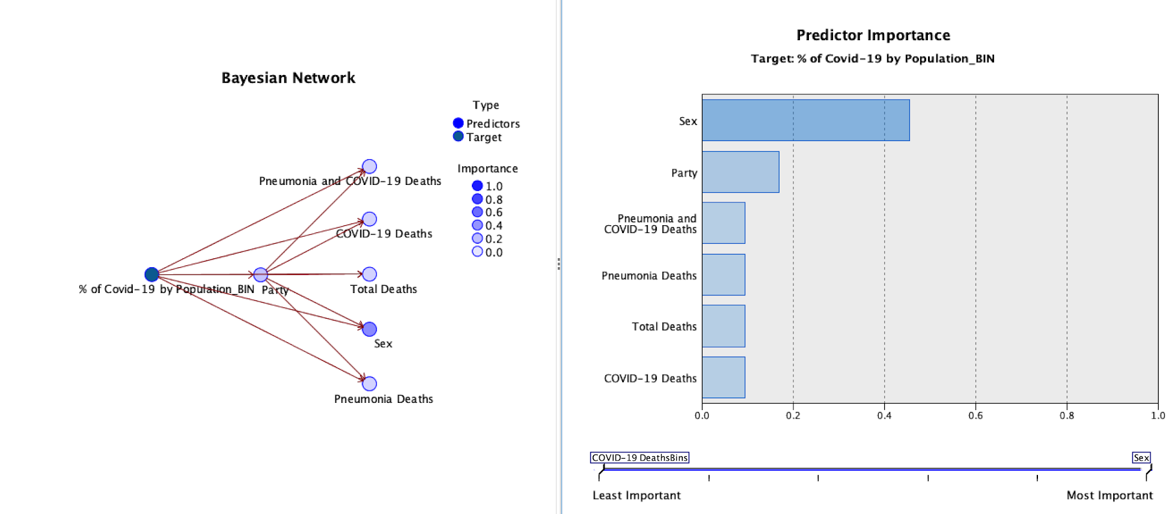
Bayesian Network
Variable selection
Input: Party, Sex, Pneumonia and COVID-19 Deaths, Pneumonia Deaths, Total Deaths, COVID-19 Deaths
Target: % of COVID-19 by Population

Slide 18
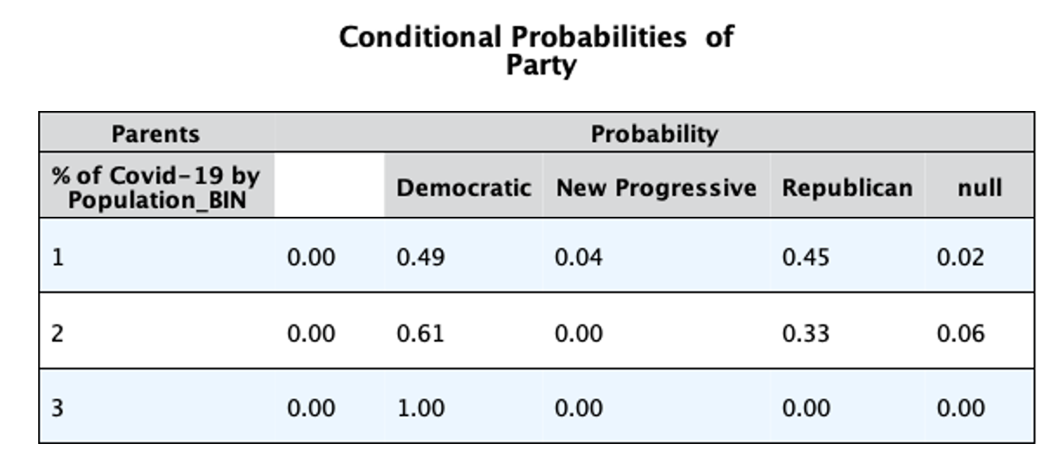
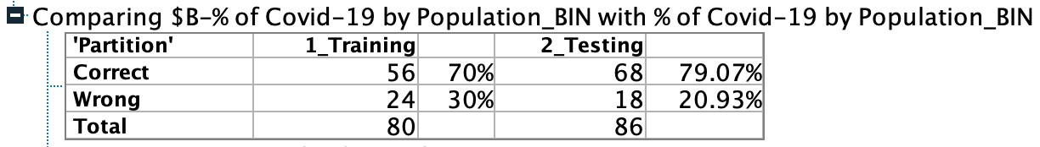
Results & Discussion -- Bayesian Network
The attribute ‘Party’ has a predictor importance of 0.17
Among those states with higher % of COVID-19 death(Bin #3), the probability of Democratic is 1.00
Accuracy is 70% for training set and 79.07% for testing set

Slide 19
Conclusions
Democrat states are at a higher risk from COVID-19
Many major cities are in Democratic states: widespread infection was present
Some policies like nursing home isolation turned these care facilities into hotspots and causing more deaths

Slide 20
Backup Slides: Decision Tree
Source node(SHARED)_AGE_GROUP.csv: List of states with associated political party, sex, age group, COVID-19 deaths and pneumonia were target/inputs
https://data.cdc.gov/api/views/9bhg-hcku/rows.csv?accessType=DOWNLOAD&bom=true&format=true
Source for political parties: https://ballotpedia.org/List_of_governors_of_the_American_states
Data used for population %::https://worldpopulationreview.com/0a3a4d7c-ceb3-4e52-bbc2-51bec63fa070
Variable excluded from analysis: influenza and week-related vectors
Notes:
Back-up slides

Slide 21
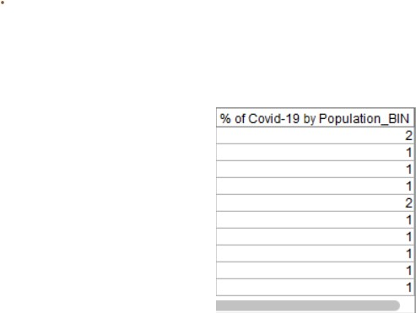
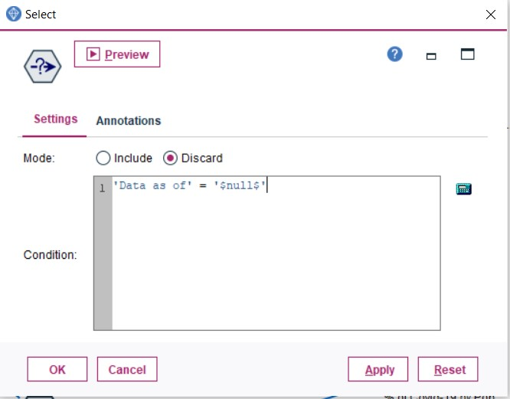
Backup Slides: Decision Tree
Preprocessing Nodes: Slide, Bin and Type nodes

Slide 22
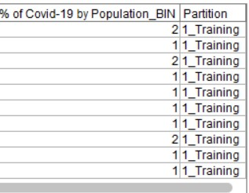
Backup Slides: Decision Tree
Model Inputs: Partition Node
Split and generated data based on Training and Testing Data Set
Result:

Slide 23
Backup Slides: Decision Tree
Model Input: C 5.0 Node
Granted a cross validation with five folds within testing and training datasets
Expert mode gave access to # of branch for model
Result:

Slide 24
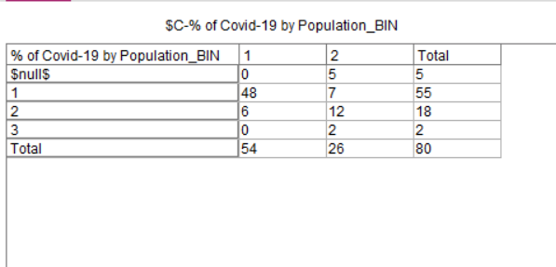
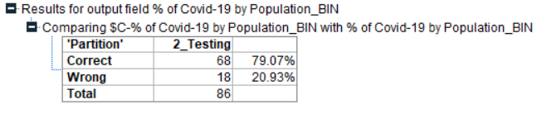
Backup Slides: Decision Tree
An analysis/matrix node is used for evaluation

Slide 25
Backup Slides ANN
Source node(SHARED)_AGE_GROUP.csv: List of states with associated political party, Sexes and age group.
https://data.cdc.gov/api/views/9bhg-hcku/rows.csv?accessType=DOWNLOAD&bom=true&format=true
Source for political parties: https://ballotpedia.org/List_of_governors_of_the_American_states
Data used for population % calculation: :https://worldpopulationreview.com/0a3a4d7c-ceb3-4e52-bbc2-51bec63fa070
Other Data: top 10 states.xls: A small spreadsheet showing the top 10 states by % of COVID-19 by population.
This was a smaller list extracted from (SHARED)_AGE_GROUP.csv

Slide 26
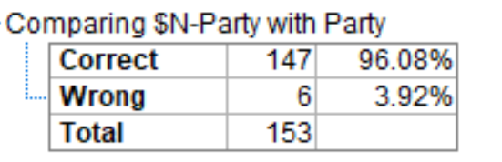
Backup Slides ANN
Model Inputs: State, % of COVID-19 by Population, Sex
Target: Political Party
Results from ANN Node:
Analysis Node: Matrix for Party Prediction

Slide 27
Backup Slides-Bayesian
Source node ALL_AGE.csv: List of states with associated political party, Sexes and age group and ‘% of COVID-19 Deaths’ is a numeric field
https://data.cdc.gov/api/views/9bhg-hcku/rows.csv?accessType=DOWNLOAD&bom=true&format=true
Source for political parties: https://ballotpedia.org/List_of_governors_of_the_American_states
Data used for population % calculation: :https://worldpopulationreview.com/0a3a4d7c-ceb3-4e52-bbc2-51bec63fa070

Slide 28
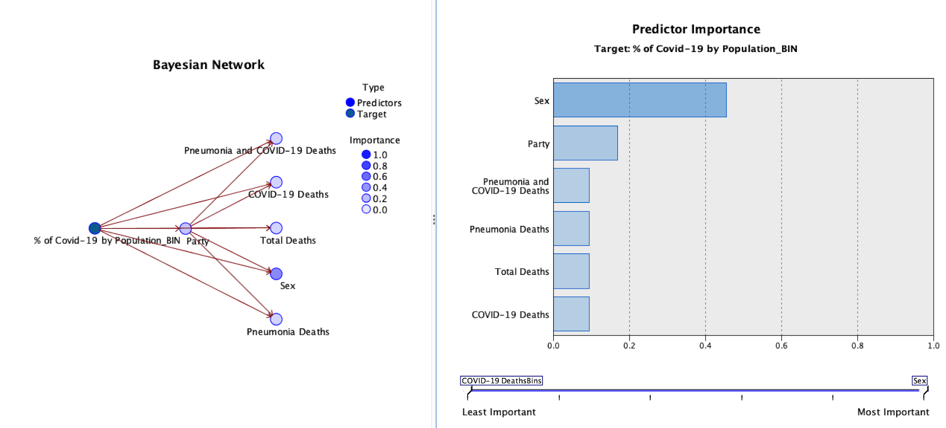
Backup Slides-Bayesian
Results from Bayesian Network

Slide 29
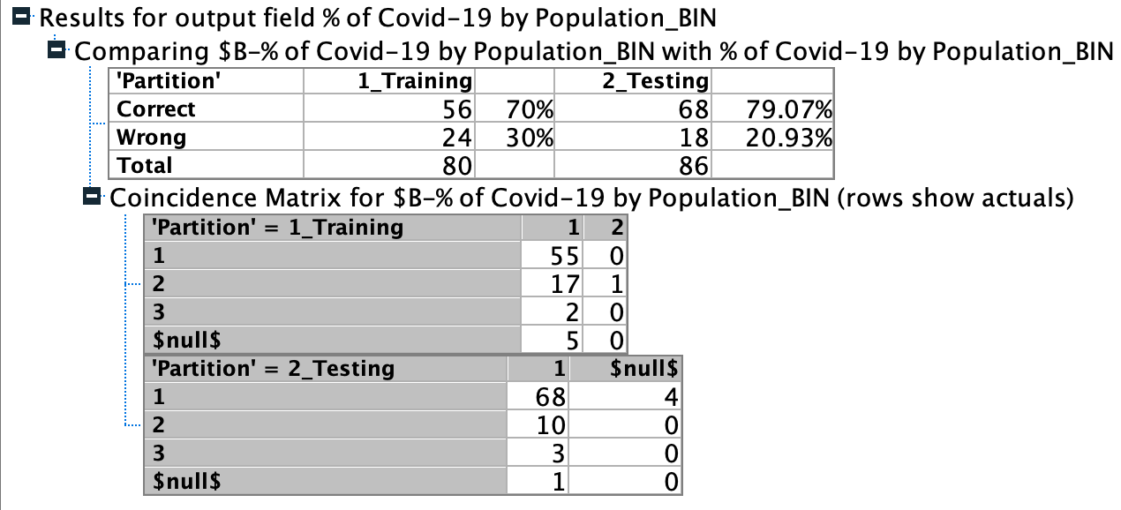
Backup Slides-Bayesian
An analysis node is used for evaluation

Slide 30
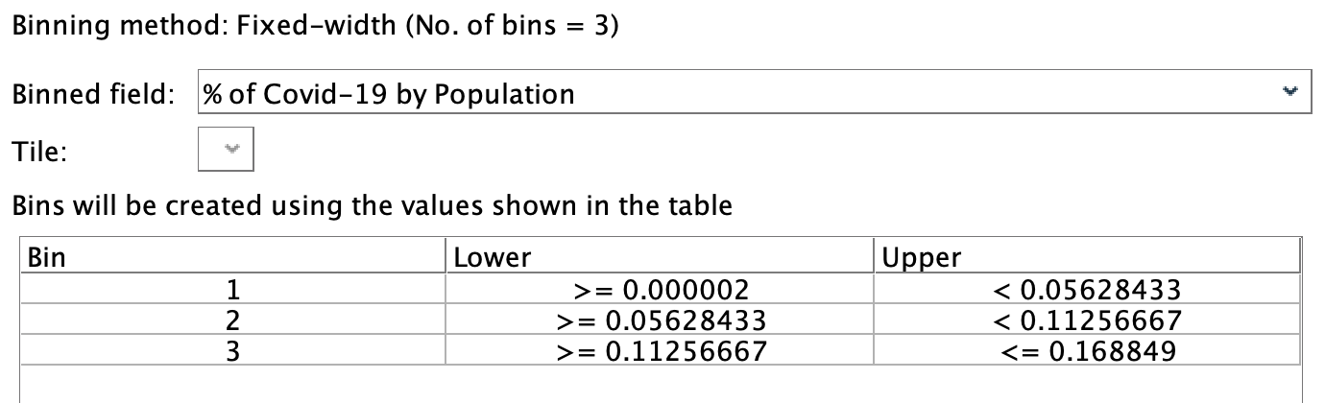
“backup slides”
Description of any other node that your team feels is important but was not described in detail in the main slides. For example, a Merge node is fairly self- explanatory, but it might depend on a set of critical Derive or Reclassify nodes.
A binning node is used in Bayesian Network
Notes:
Back-up slides

